Slide 1
Group 5 Check-In
Maze Solving in Python

Slide 2
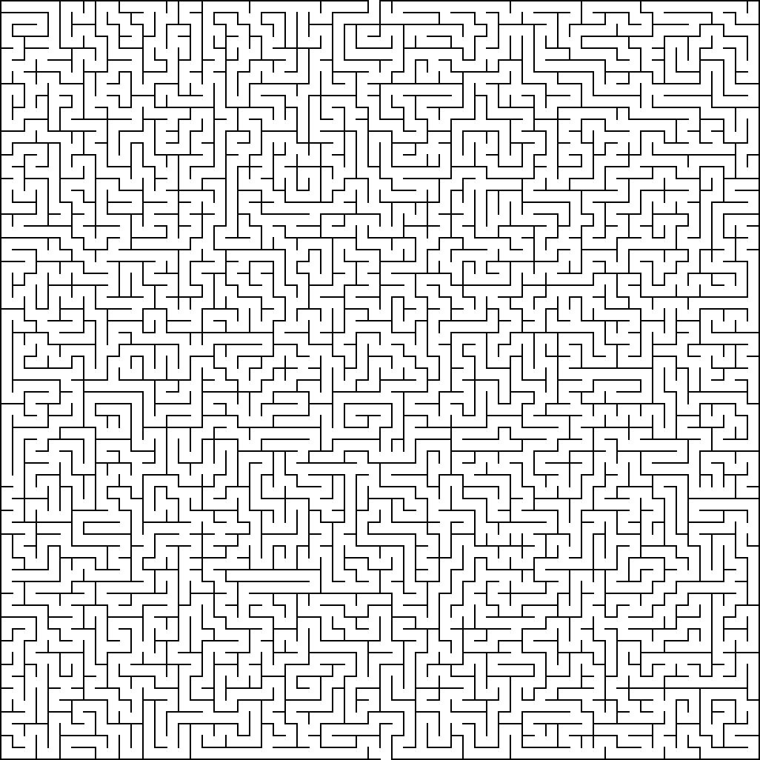
Loading MAZE_0 into a Python script
- We will solve this Maze by loading it into Python and having it generate the solution for us to view.

Slide 3
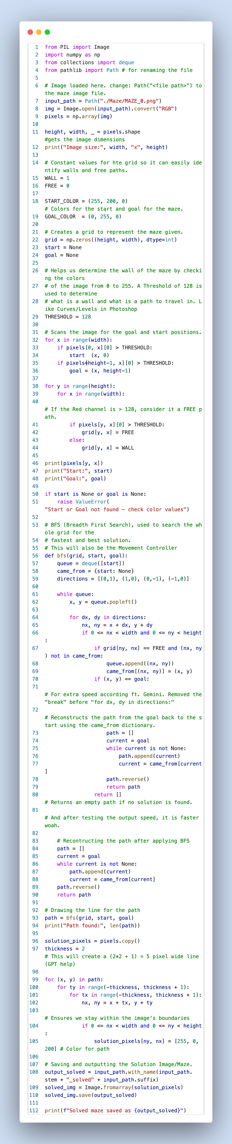

Slide 4
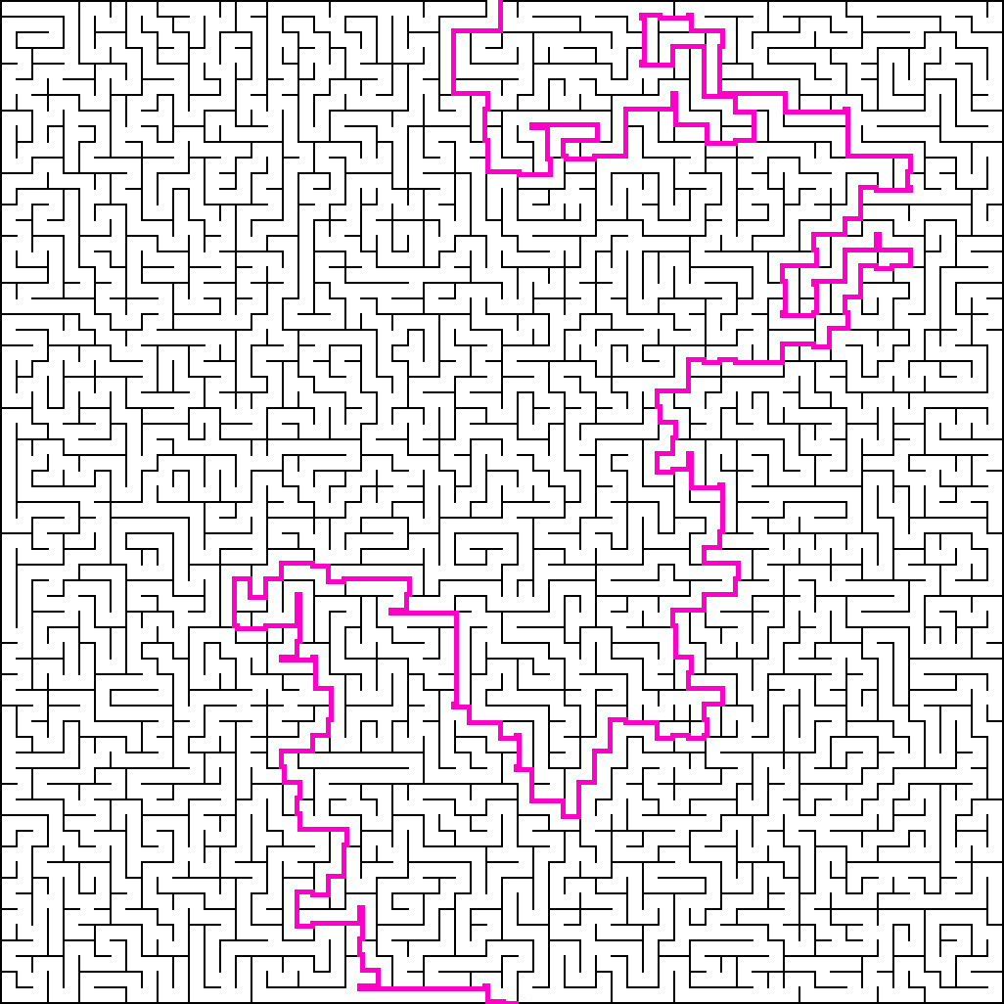
Solved Maze

Slide 5
Maze Notes: Why am I using Breadth First Search instead of A*(A-star) Search?
Breadth First Search simply works with the Maze images provided.
Pros: It guarantees to find the shortest path possible by moving in all directions equally form the start.
Cons: However, it can be “blind” as in spending more time exploring dead ends as since it will explore everything, it needs to read everything even if the “exit/goal” is close.
It’s good for this Maze since it isn’t that big, but for bigger Mazes much larger than this, A* can be better.
A* Search
It acts like Breadth First Search, but calculates the distance already travelled plus an estimate on how much farther it needs to travel to meet the “goal.” (Heuristic function)
Pros: It focuses on paths that seem like that are heading towards the exit. This means it doesn’t have to search everything like BFS, meaning we save more memory on a good case scenario.
Cons: It’s more complex to code since it requires a priority queue, and if our heuristic function is bad, then it might not be able to estimate the shortest path thus causing high memory, or similar memory to BFS than it would if it were better.
This is usually good for High resolution images or real time games since those take up a lot of memory IF you were to just straight up use BFS.
Misc: Maze Notes

